Slide 1

Literature Sources Analysis Using Deep Impostor Approach
Presented by: Ofir Uziel, Emanuel Davidov
Supervisor: Prof. Zeev Volkovich, Dr. Renata Avros

Slide 2





Table of Contents
Problem & Solution
Problem Definition, Project Aim, Proposed Solution Overview
System Architecture
Detailed System Architecture, Data Preparation, Embedding Generation
Models & Implementation
Classification Models, Signal Construction, Boundary Detection, UML Diagrams, Implementation Workflow
Evaluation & Conclusion
Testing Plan, Innovation, Applications, Evaluation Methodology, Summary and Future Directions

Slide 3

Problem Definition
1
Traditional Assumptions
Current methods assume uniform authorship, overlooking collaborative writing processes that create stylistic variations within texts.
2
Detection Challenges
Existing approaches fail to identify stylistic shifts within documents, missing signals of authorship changes or editorial interventions.
3
Technical Limitations
Current solutions struggle with multi-authored texts, depend on scarce labeled data, and lack interpretability of detected stylistic changes.

Slide 4





Project Purpose
Unsupervised Framework
Alternation Point Detection
Develop deep learning solution without labeled data
Identify internal stylistic shifts clearly
Noise Filtering
Interpretable Visualization
Eliminate irrelevant stylistic variations
Provide clear visual analysis tools
Our main objective is to create an advanced framework that can detect stylistic changes within documents without requiring pre-labeled training data. This solution will provide researchers and analysts with powerful tools to understand document authorship patterns.

Slide 5

Proposed Solution Overview
1
Deep Impostor Method
2
Stylistic Classification
Utilize a novel approach introduced by Avros and Volkovich combining impostor comparisons with deep neural models to detect stylistic variations without supervision.
Classify document segments against stylistically distinct impostor corpora to identify potential authorship shifts.
3
Signal Generation
4
Multiview Detection
Generate continuous stylistic signals and apply statistical methods to detect internal boundaries where writing style changes.
Ensure accurate boundary identification through voting across multiple classifiers to minimize false positives.

Slide 6











Detailed System Architecture
Word Embedding
Text Segmentation
Convert text to vectors using Word2Vec and BERT
Divide documents into the analyzed units
Stylistic Classification
Apply CNN-BiLSTM and BERT-based models
Boundary Detection
Apply consensus-based voting mechanism
Signal Creation Analysis
Construct and analyze stylistic patterns
The system architecture integrates multiple components working in sequence to process text, generate meaningful representations, and identify stylistic boundaries through sophisticated analysis techniques.

Slide 7




Data Preparation
Document Input
Tokenization
Chunking
Raw text documents
Fixed-length batches (e.g. 50 words)
8 batches per chunk (e.g. 400 words)
The data preparation process ensures consistent, structured input for the stylistic modeling system. By breaking documents into standardized units, we create uniform segments that can be effectively analyzed for stylistic patterns and variations.
This systematic approach allows for more reliable comparison across different parts of a document, enabling the detection of subtle stylistic shifts that might indicate changes in authorship or significant editorial intervention.

Slide 8

Embedding Generation
Word2Vec (Skip-Gram)
BERT (Transformer)
A computationally efficient embedding technique that captures lexical-level features by predicting context words from target words.
A context-sensitive embedding approach that captures sentence-level semantics through bidirectional attention mechanisms.
Captures word relationships
Context-aware representations
Efficient processing
Captures semantic nuances
Strong lexical representation
Pre-trained on massive corpora
Both embedding techniques transform text into numerical vectors that represent semantic and stylistic properties, creating matrices that serve as input for our classification models. These complementary approaches ensure comprehensive capture of stylistic signals.

Slide 9

Stylistic Classification Models
CNN-BiLSTM Model
BERT Classifier
Combines convolutional neural networks to extract local textual patterns with bidirectional LSTM networks to preserve long-range dependencies. This hybrid architecture effectively captures both n-gram features and sequential context.
Leverages transformer architecture for contextual embeddings and classification. Excels at detecting nuanced stylistic differences through pre-trained language understanding and targeted fine-tuning for style classification.
Both models classify text segments by stylistic alignment to impostor texts, detecting subtle authorial signals within documents.

Slide 10

Stylistic Signal Construction
Batch-Level Classification
Continuous Signal Generation
Generate probability scores for each batch against impostor corpora
Create a continuous signal reflecting stylistic alignment
1
2
3
4
Chunk-Level Aggregation
Signal Interpretation
Combine batch probabilities into chunk scores
Analyze extreme values (0 or 1) for stylistic clarity and abrupt shifts for stylistic changes

Slide 11





Changepoint Detection
Rolling Distance Calculation
Compute average squared stylistic differences between consecutive chunks to identify potential transition points in the document's stylistic flow.
Changepoint Identification
Analyze the distance signal using wavelet transformations to locate significant peaks that exceed a statistical threshold, marking them as candidate stylistic boundaries.
Consensus Voting
Apply a majority voting mechanism across multiple classifier outputs to validate peaks and ensure reliable, robust detection of genuine stylistic changes.
Boundary Finalization
Establish final stylistic boundaries based on consensus results, providing clear demarcation of stylistic shifts within the document.

Slide 12

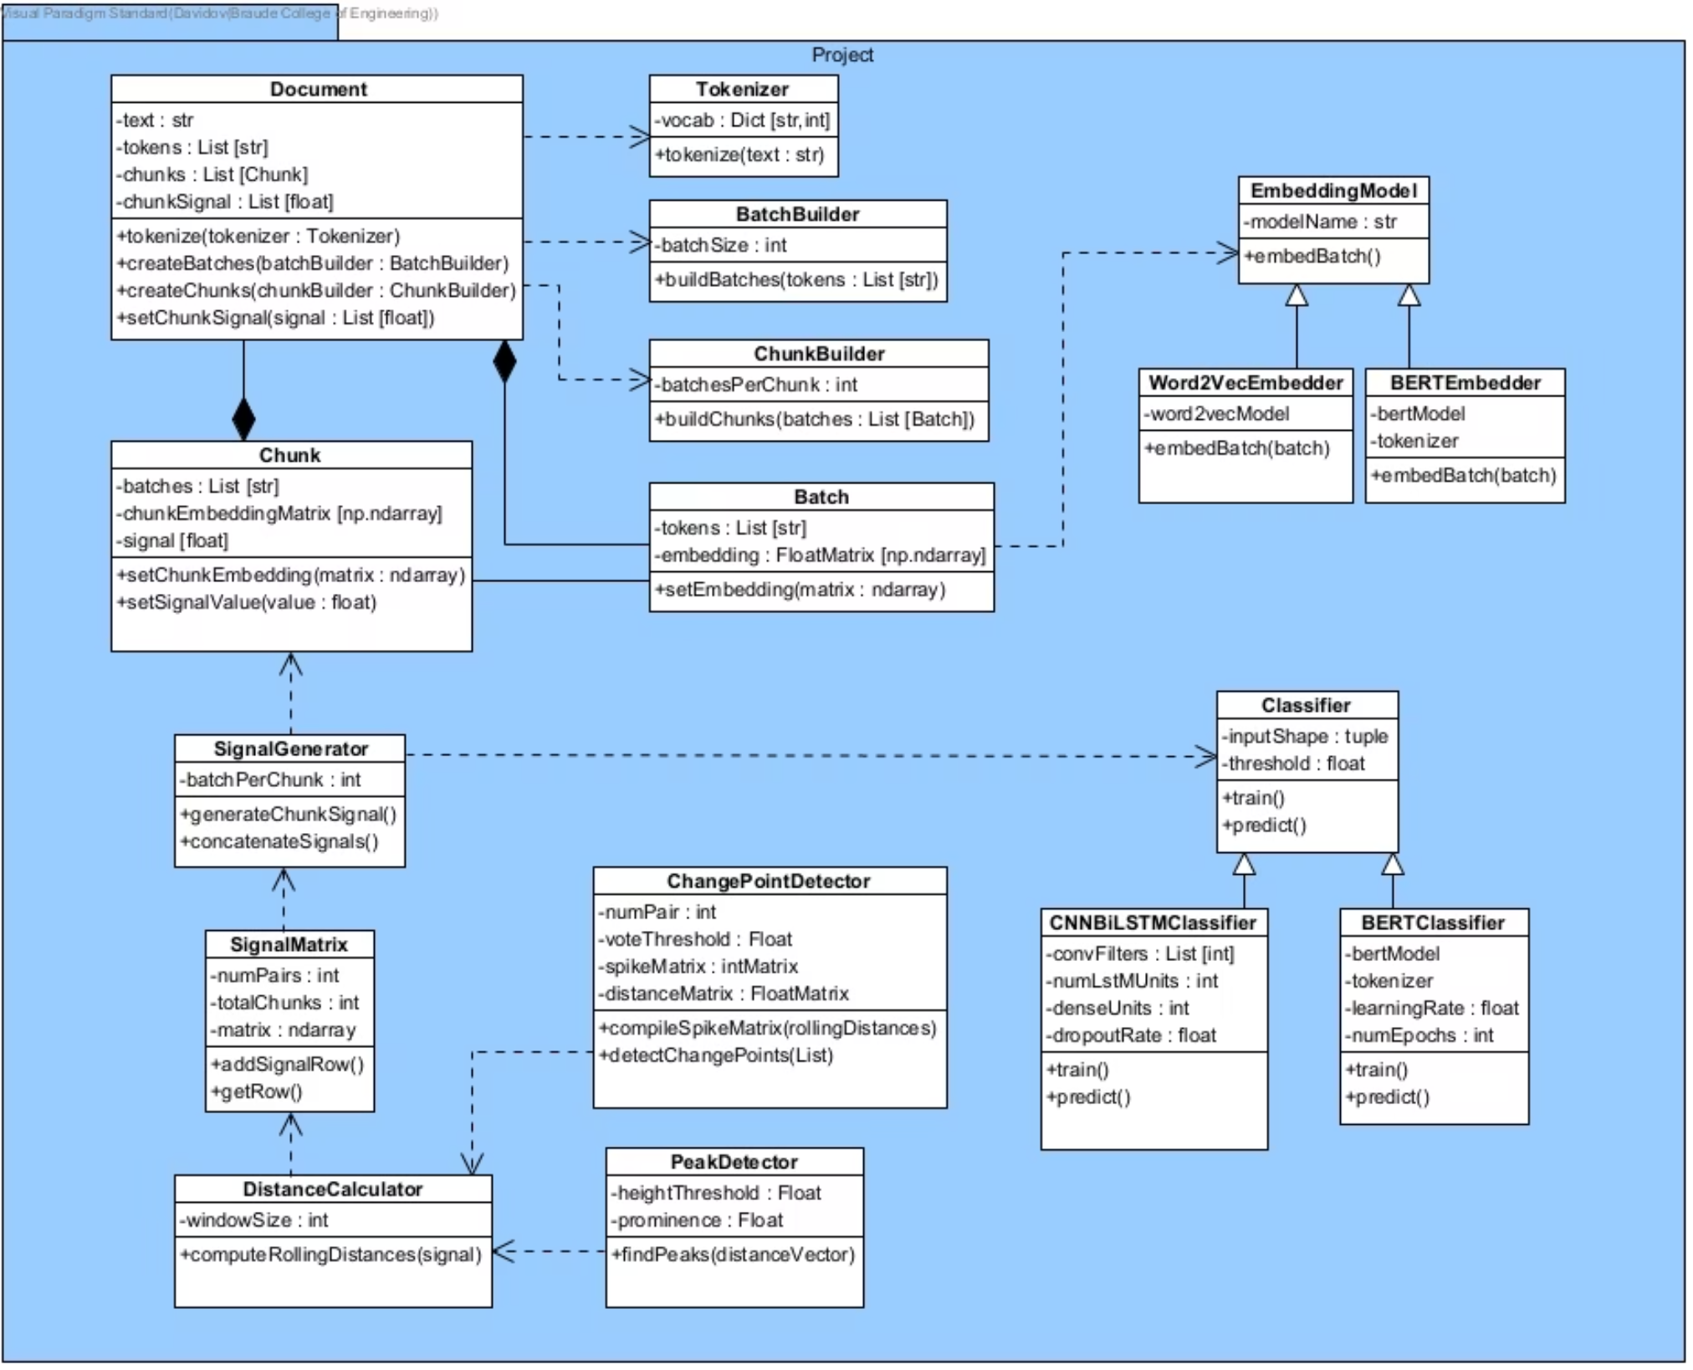
UML - Class Diagram

Slide 13

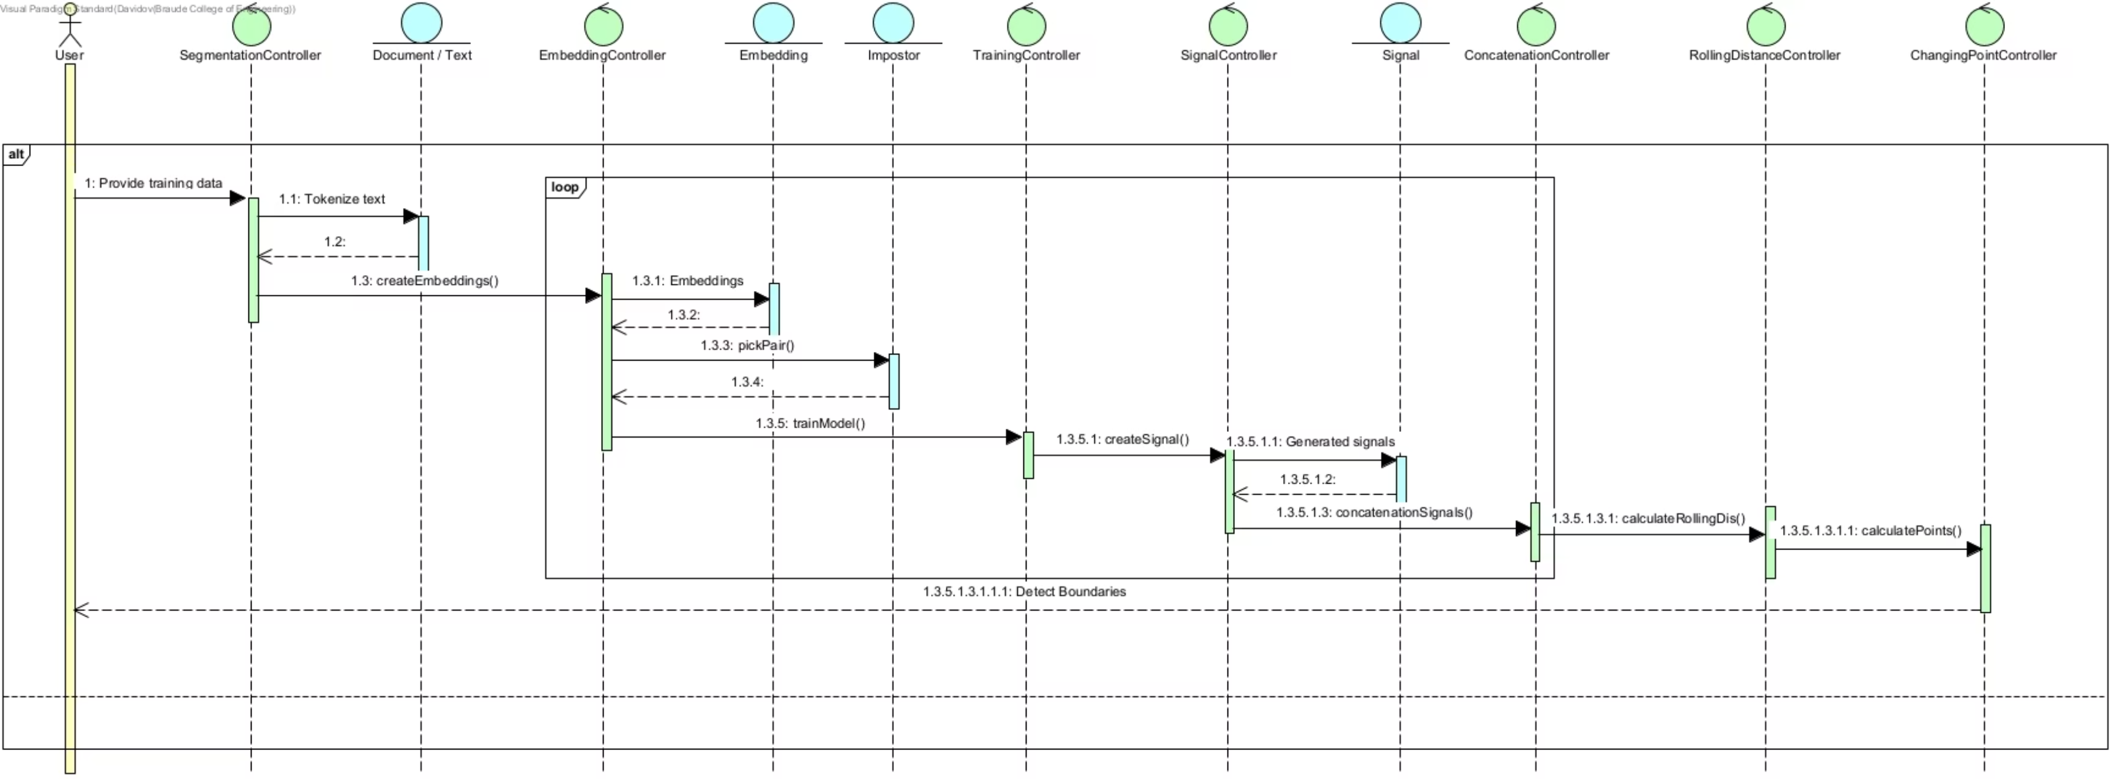
UML - Sequence Diagram

Slide 14

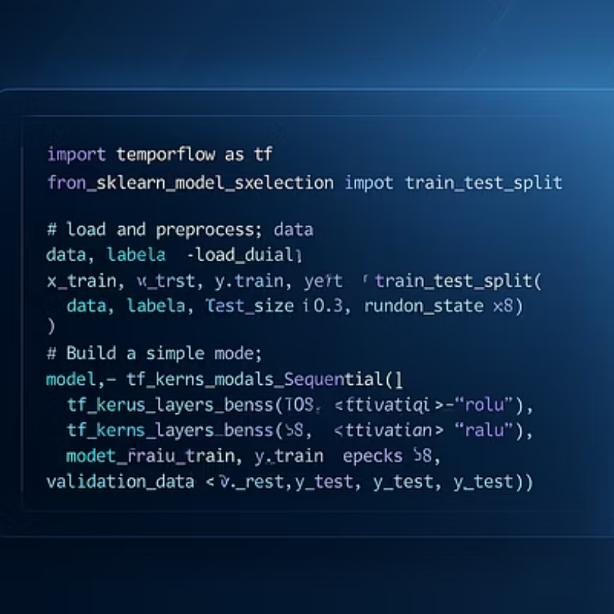
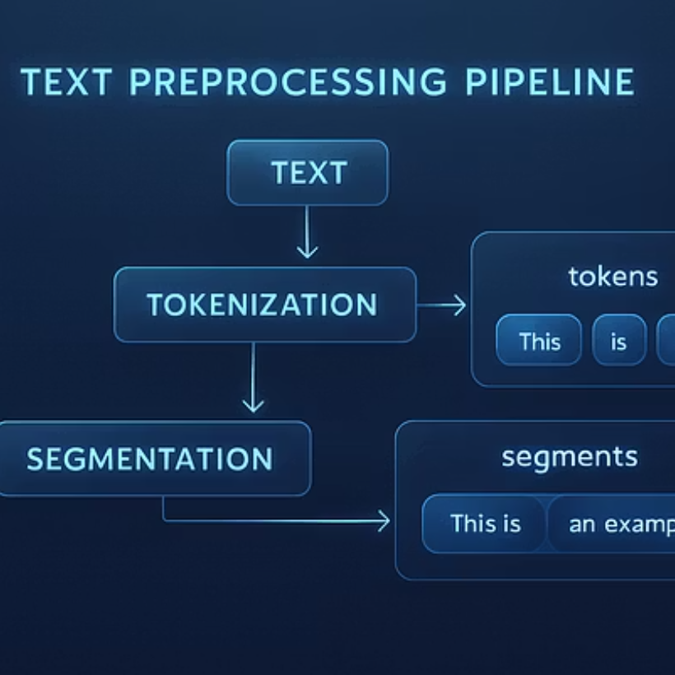
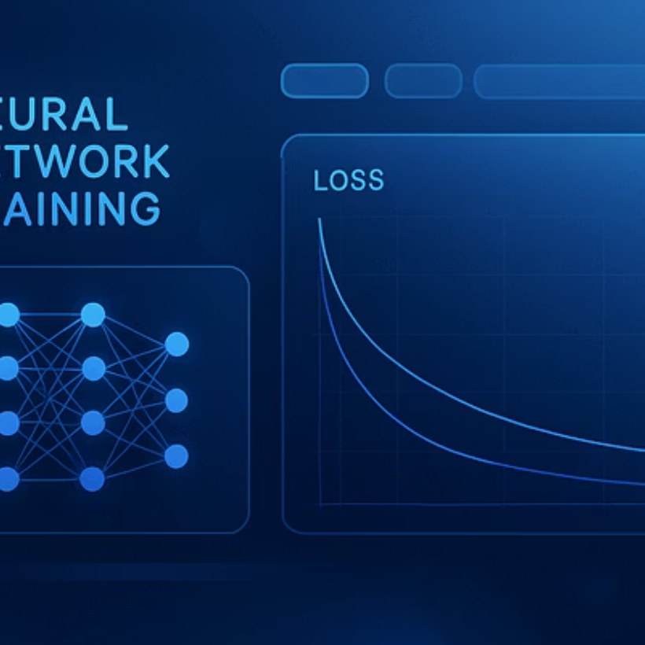
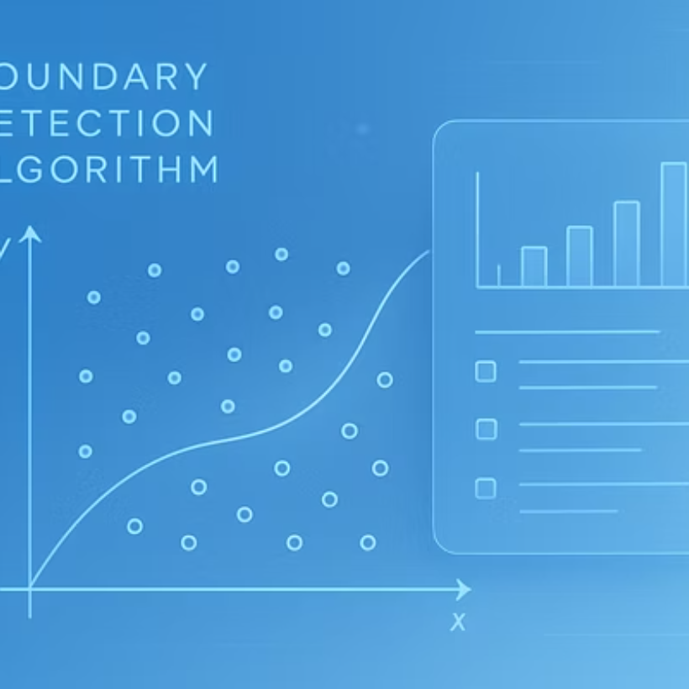
Implementation Workflow
The suggested implementation is going to be based on Python 3.10 in the Google Colab environment with a comprehensive technical stack including TensorFlow, scikit-learn, NumPy, pandas, transformers, gensim, and NLTK. The workflow progresses through distinct stages as mentioned on slide 6.

Slide 15




Testing Plan
Testing Objective
Ground Truth Creation
Our testing objective is to verify the system's reliability in identifying stylistic shifts within documents.
We will create synthetic texts with manually annotated boundaries to serve as ground truth for evaluation.
Testing Procedure
Evaluation Metrics
The testing procedure will involve multiple impostor-classifier configurations to ensure robust performance across different scenarios.
Evaluation will focus on precision (accurate boundary detection), recall (complete boundary coverage), and F1-score (balanced performance measure), with particular attention to minimizing false positives while maximizing true positive detection.

Slide 16

Formal Testing Plan
Component
Test/Unit
Input
Expected Output
Evaluation Method
Tokenizer & Batching
Tokenization accuracy, batch integrity
Raw text documents (diverse styles)
Correctly tokenized sequences, fixed-size batches
Manual inspection, assert batch dimensions, vocabulary verification
Embedding Generation
Semantic coherence, dimensional consistency
Tokenized text batches
Contextually relevant numerical vector representations
Cosine similarity for related texts, dimensionality checks
Classifier (CNN/BERT)
Stylistic discrimination accuracy
Embeddings of stylistic chunks, ground truth labels
Correct classification of stylistic origin
Precision, Recall, F1-score against ground truth (synthetic data)
Chunk Aggregation
Correct combination of chunk outputs
Classifier outputs (labels/probabilities)
Coherent, aggregated stylistic representations
Cross-validation with known changes, consistency checks
Signal Generation
Signal robustness and responsiveness
Aggregated chunk data
Clear stylistic signal indicating shifts
Visual inspection of plots on synthetic data with known boundaries
Rolling Distance Calculation
Accuracy of distance metric computation
Stylistic signal data
Quantified stylistic divergence between windows
Numerical validation against manual calculations, sensitivity analysis
Spike/Peak Detection
Precision and recall of boundary identification
Rolling distance signal
Accurate detection of significant peaks
Comparison against ground truth boundaries
Voting Mechanism
Consensus formation for final boundaries
Multiple impostor-classifier boundary proposals
Consolidated, robust final stylistic boundaries
Agreement rate, F1-score on combined results vs. ground truth
Evaluation Metrics
Correctness of metric calculations
Detected and ground truth boundaries
Accurate Precision, Recall, F1-score
Manual verification, comparison with standard library implementations

Slide 17

Evaluation Methodology
Dataset Preparation
We create test documents by concatenating distinct author segments with clear stylistic differences. These documents are then manually annotated to establish ground truth boundaries that serve as the reference for our evaluation metrics.
Performance Metrics
Our evaluation employs precision, recall, and F1-score metrics with a margin of error (±1 chunk) to account for minor inaccuracies in boundary detection. This approach provides a comprehensive assessment of the system's detection capabilities.
Visualization
We plot stylistic signals with both predicted and actual boundary indicators, enabling visual comparison of system performance against ground truth and facilitating intuitive understanding of detection accuracy.

Slide 18
Innovation & Contributions
Methodological Innovation
Scientific & Practical Contribution
Our approach introduces deep neural networks into the impostor methodology, creating a novel unsupervised and interpretable stylistic segmentation framework. This represents a significant advancement over traditional methods that rely on supervised learning or simplistic statistical approaches.
The system provides improved analysis capabilities for complex, multi-authored texts, enhancing transparency in literary forensics, digital editing, and plagiarism detection. These contributions have significant implications for both academic research and practical applications in publishing and content verification.
Integration of deep learning with impostor techniques
Enhanced multi-author text analysis
Unsupervised boundary detection
Improved literary forensics tools
Interpretable stylistic analysis
Advanced plagiarism detection

Slide 19
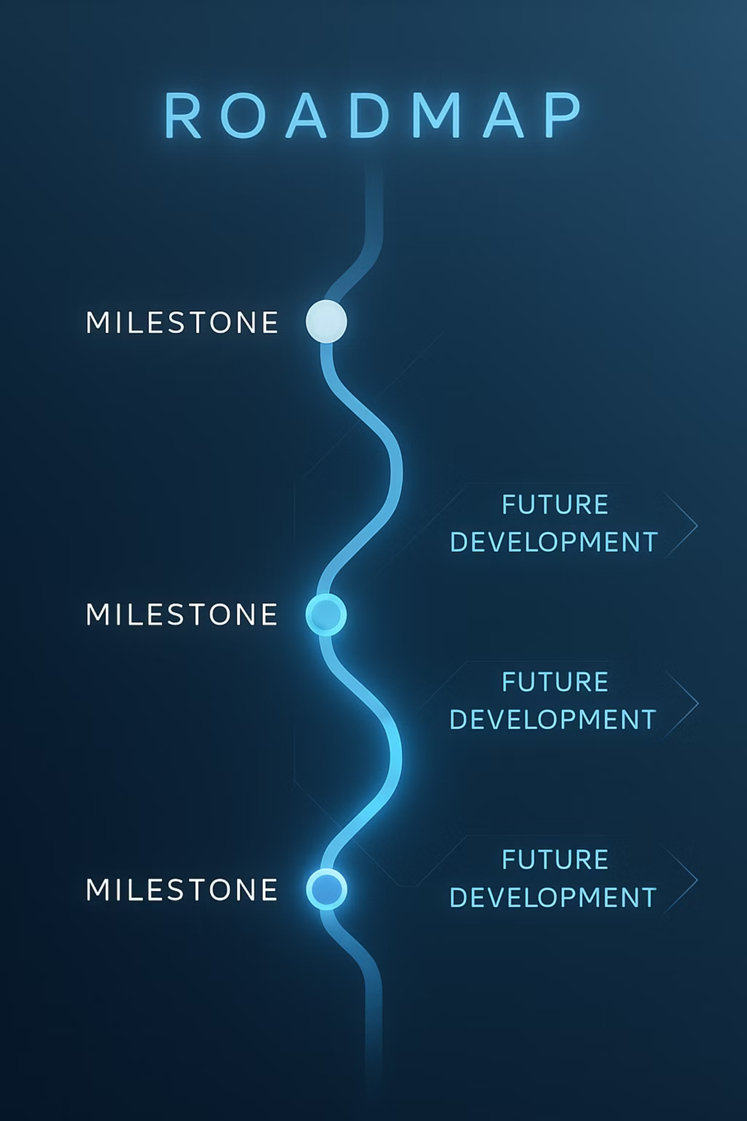
Summary and Future Directions
Phase A Achievements
Phase B Next Steps
Clear definition of stylistic segmentation problem
Comprehensive classifier training and optimization
Developed robust deep impostor-based pipeline
Large-scale real-world testing and benchmarking
Established testing and evaluation framework
Fine-tuning voting mechanisms for accuracy
Explore multilingual and cross-genre generalization
We have successfully defined the stylistic segmentation problem and developed a comprehensive solution approach using deep impostor methods. Our robust pipeline and evaluation framework provide a solid foundation for further development.
Moving forward, we will focus on optimizing classifiers, conducting extensive real-world testing, refining our boundary detection mechanisms, and exploring applications across different languages and genres to enhance the system's versatility and practical utility.

Slide 20

Thank You
Acknowledgments
Special thanks to Dr. Renata Avros and Prof. Zeev Volkovich for guidance and support throughout this research project. Additional appreciation to Braude College Software Engineering Department for providing resources and academic environment.
Contact Information
For questions, feedback, or collaboration opportunities, please reach out to Ofir Uziel. Your insights and suggestions are valuable for the continued development of this research.
Questions Welcome
Thank you for your attention! We welcome any questions about the methodology, implementation details, or potential applications of our stylistic analysis framework.

